Slide 1
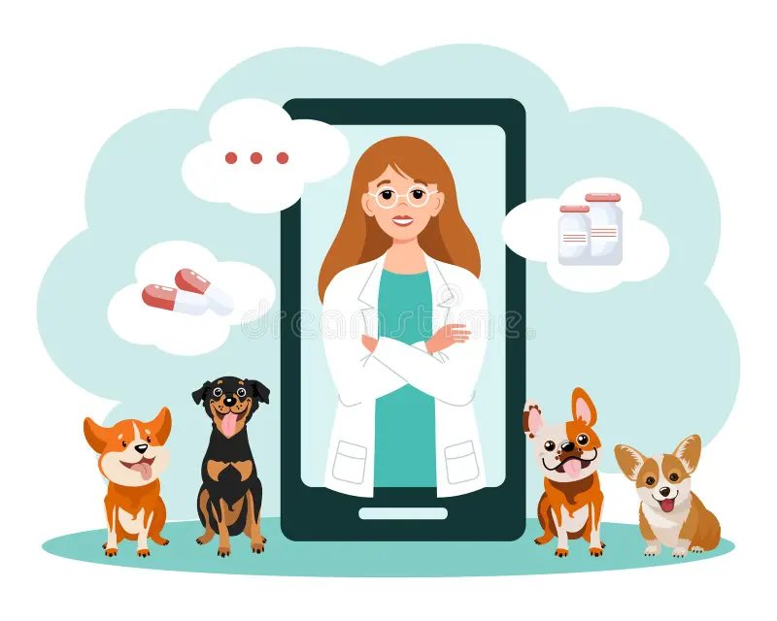
Smart Veterinary Care System with AI-Based Disease Detection
Group 05 | Rishat Bin Sultan, MD Tamim Hasan, Fariha Islam

Slide 2

Course Code: CSE 299 Section: 04 Project Group: 05 Group Members: Rishat Bin Sultan (2312559042) MD Tamim Hasan (2232239642) Fariha Islam (2311101642)
Group 05 | Rishat Bin Sultan, MD Tamim Hasan, Fariha Islam

Slide 3
Problem Statement
Limited access to veterinary services (distance, time constraints)
Delay in identifying common pet diseases
Difficulty obtaining veterinary products quickly
Existing platforms lack intelligent health-support features
Group 05 | Rishat Bin Sultan, MD Tamim Hasan, Fariha Islam

Slide 4
Project objectives
Develop a user-friendly online veterinary shop
Provide AI-based preliminary disease detection
Offer basic disease information and precautions
Integrate product recommendations with disease results
Ensure efficient admin and delivery management
Group 05 | Rishat Bin Sultan, MD Tamim Hasan, Fariha Islam

Slide 5

Proposed Solution
Online veterinary e-commerce system
AI-based disease detection (image/symptom based)
Centralized system for users, admin, and delivery
Goal: Improve accessibility, awareness, and convenience
Group 05 | Rishat Bin Sultan, MD Tamim Hasan, Fariha Islam

Slide 6
System Modules Overview
User Module
Online Veterinary Shop Module
AI-Based Disease Detection Module
Admin Module
Delivery Person Module
Group 05 | Rishat Bin Sultan, MD Tamim Hasan, Fariha Islam

Slide 7
System Architecture
Three-tier architecture
Presentation Layer: Web Interface
Application Layer: Django Backend + AI Model
Data Layer: Relational Database
Group 05 | Rishat Bin Sultan, MD Tamim Hasan, Fariha Islam

Slide 8
Methodology
Requirement analysis and design
Database and frontend development
Backend implementation with Django
Dataset collection and preprocessing
AI model training and evaluation
System integration and testing
Group 05 | Rishat Bin Sultan, MD Tamim Hasan, Fariha Islam

Slide 9
Tools & Technologies
Backend: Python, Django
Frontend: HTML, CSS, Bootstrap
Database: SQLite / MySQL
Machine Learning: scikit-learn / basic DL
Tools: VS Code, Web Browser
Group 05 | Rishat Bin Sultan, MD Tamim Hasan, Fariha Islam

Slide 10
Expected Outcomes
Functional online veterinary shop
AI-supported early disease awareness
Improved access to products and guidance
Efficient system management
Group 05 | Rishat Bin Sultan, MD Tamim Hasan, Fariha Islam

Slide 11

Conclusion
Combines e-commerce with AI-based health support
Enhances convenience and early awareness
Supports informed decision-making for pet owners
Group 05 | Rishat Bin Sultan, MD Tamim Hasan, Fariha Islam

